Slide 1
Emergency Response and the NRF
NUEN 657
Dr. Craig M. Marianno

Slide 2
Goals for the day
Basic understanding of what is needed and why during a response
Get an idea of the history of response plans
Introduce you to the National Response Framework (NRF)
  Understand its mission areas and objectives
At the end of the lecture
  Give me the basics of what is needed and why in a response
  The short term and long-term objectives of a radiological response
  You should be able to tell me what the NRF is why it is important to emergency response

Slide 3
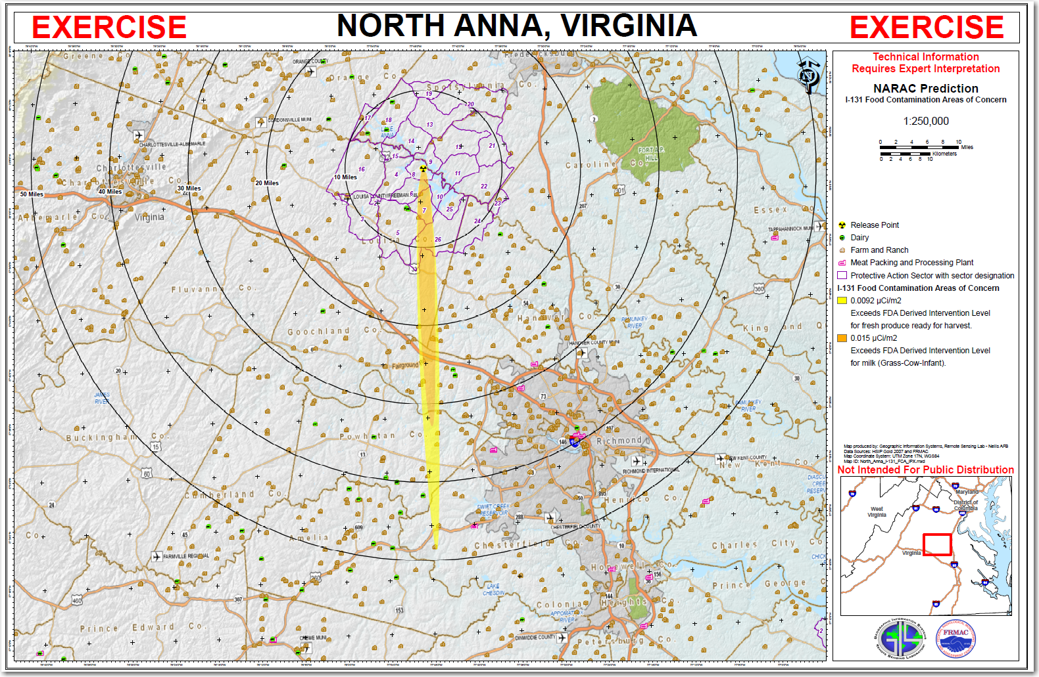
How bad can it be?

Slide 4
As a responding scientist what do you need?
What data do you need?

Slide 5
How would you get that data?

Slide 6
Objectives of Radiological Emergency Response

Slide 7
As a decision maker, what do I need to know
First, a decision maker is the person who will make the final decisions regarding public safety (evacuations, relocations, embargos)
What do they need to know?

Slide 8
History of National Response Agencies
1979 – First US comprehensive plan for federal emergency response:
  Federal Emergency management existed in 1 form or another for since ~1803
  Between 1803-1979 piecemeal approach to disaster relief
  FEMA first charged with absorbing ER duties from multiple agencies with disjointed plans
1988 –
  Established a system of federal assistance to state and local governments and required all states to prepare individual Emergency Operations Plans
2003 –

Slide 9
Response Plans
1992 – Federal Response Plan (FRP)
  Augmented by 1968 National Contingency Plan (NCP) – originally intended for oil spills
  Scope expanded by 1980 Comprehensive Environmental Response, Compensation and Liability Act – included emergency hazardous waste removal and facility-specific contingency plans
1996 –
2003 –

Slide 10
National Response Structures
2003 – Homeland Security Presidential Directive 5 (HPSD-5) directs the development of the National Incident Management System (NIMS)
  NIMS adopted throughout all federal agencies
  Emergency management doctrine that coordinates emergency preparedness and incident management among public and private sectors
  Provides the template for the management of the incident (how the event should be organized)
2004 – National Response Plan (NRP) –
  Provides the structure and mechanisms for national level policy for incident management
  Addresses natural disasters and terrorist attacks
  Updated after Hurricanes Katrina, Wilma, and Rita in 2005
2008 –

Slide 11
NRF response vision
NRF sets the strategy and doctrine for how the whole community builds, sustains, and delivers the response core capabilities identified in the National Preparedness Goal (NPG) in an integrated manner with the other mission areas. (Documents are available in Canvas)
NPG: “A secure and resilient nation with the capabilities required across the whole community to prevent, protect against, mitigate, respond to, and recover from the threats and hazards that pose the greatest risk.”
  5 mission areas:

Slide 12
NRF the Document!
National Response Framework is comprised of
  Core Document (51 pages!!)
  Emergency Support Function (ESF) Annexes – describe the federal coordinating structures that group resources and capabilities into functional areas most frequently needed in a national response
  Support Annexes – describe other mechanisms by which support is organized among private sector, NGO, and federal partners. The support annexes describe the essential supporting processes and considerations common to most incidents. Content found within the support annexes is superseded by changes and updates to legislation.
Previously had “Incident Annexes” – These are now under the Federal Interagency Operational Plan (FIOP) incident annexes (link in Canvas)
  address the unique aspects of how we respond to seven broad incident categories (e.g., biological, nuclear/radiological, cyber, mass evacuation, etc.)
Two other annexes have been removed and are now in ESF #14

Slide 13
NRF Core principles
5 key principles (page 5 NRF)

Slide 14
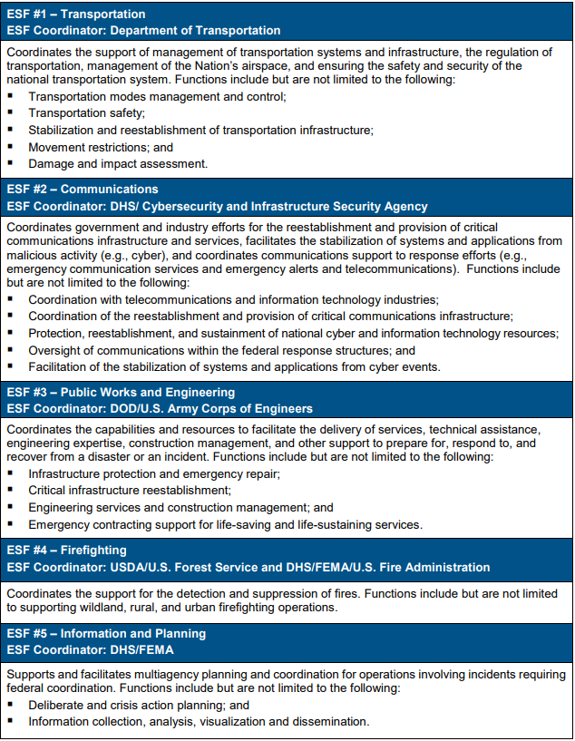
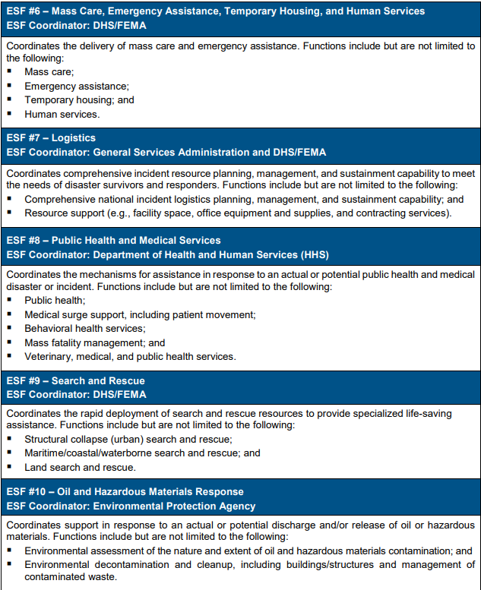
Emergency Support Functions

Slide 15
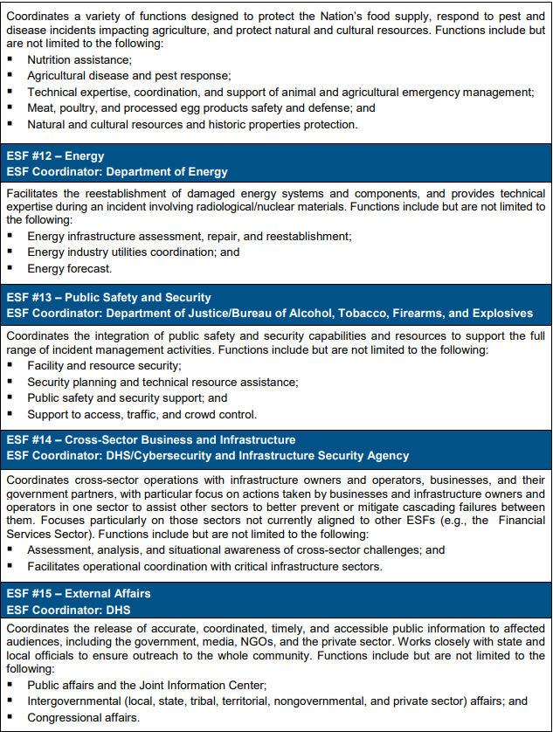
ESFs Continued

